Slide 1

Computational Fluid Dynamics(CFD) Of a Propeller
RAGHU ENGINEERING COLLEGE
(Autonomous)
(approved by AICTE, New Delhi & Permanently Affiliated to JNTUK, Kakinada)
NBA and NAAC ‘A+’ grade accredited Institute.
S N0 | NAMES | REG N0
1 | T Appalanaidu | 20981A03B8
2 | N Swetha Sri | 20981A0387
3 | V Ganesh | 20981A03C5
4 | SK Rafee | 20981A03B4
5 | V Vijay Kumar | 20981A03C4
Department & College:
Department of Mechanical Engineering
Raghu Engineering College
Guide's Name with Designation:
Dr.CH SRINIVASU Ph.D

Slide 2
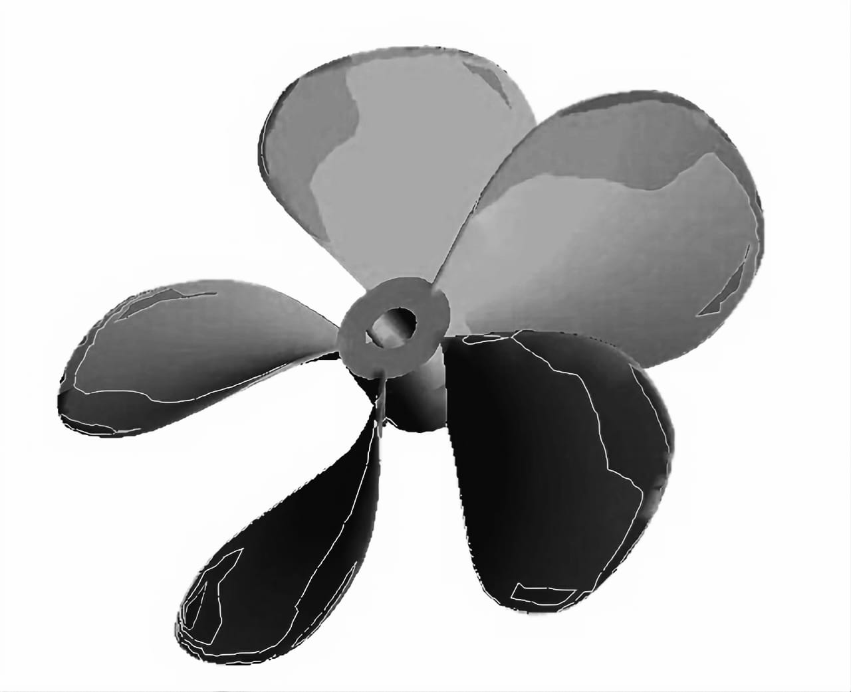
CONTENTS:
ABSTRACT
INTRODUCTION TO CFD
LITERATURE SURVEY
CFD ON PROPELLER
MATERIAL
DESIGN
NEED FOR CFD
FUTURE SCOPR FOR CFD
ADVANTAGES OF CFD ANALYSIS
DIS-ADVANTAGES OF CFD ANALYSIS
APPLICATIONS
3D MODELS OF DIFFERENT TYPES OF PROPELLER
SIMULATIONS & ANALYSIS
COMPARATIONS & RESULTS
CONCLUSION

Slide 3
ABSTRACT
This project aims to conduct a Computational Fluid Dynamics (CFD) analysis of a propeller using CATIA V5 and ANSYS software. The propeller under investigation is modeled and simulated to understand its aerodynamic performance characteristics, including thrust generation and efficiency. CATIA V5 is utilized for the initial design and 3D modeling of the propeller geometry, ensuring accuracy and precision in the representation of its features. ANSYS software is then employed to perform the CFD simulations, which involve solving the Navier-Stokes equations to predict fluid flow behavior around the propeller. Through this analysis, parameters such as thrust, torque, pressure distribution, and velocity profiles are evaluated to assess the propeller's performance under different operating conditions. The results obtained from the simulations are compared with experimental data or standard benchmarks to validate the accuracy and reliability of the computational model. This project contributes to a deeper understanding of propeller aerodynamics and provides insights into optimizing propeller designs for various applications, such as aerospace, marine propulsion, and industrial fans.

Slide 4
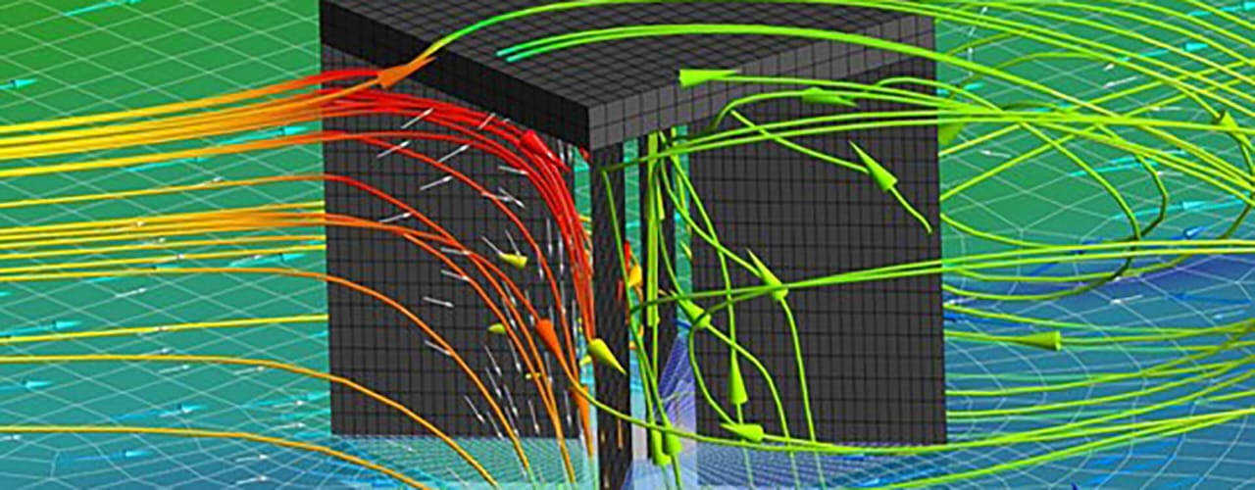
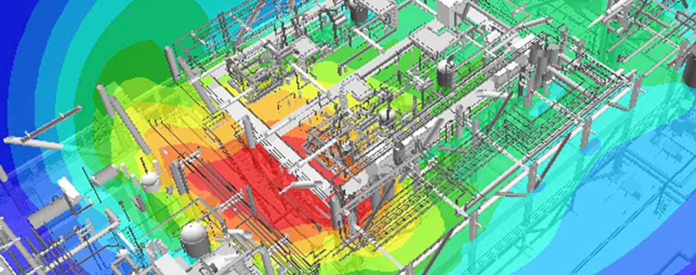
INTRODUCTION TO CFD:
Computational Fluid Dynamics (CFD) is a branch of fluid mechanics that uses numerical methods to solve and analyze problems involving fluid flows. CFD is used to simulate the flow of air or liquid around objects, such as aircraft wings and car bodies, and to predict the effects of changes in the environment on these objects.
The main advantage of CFD is that it can provide detailed information about information about fluid flow behavior, such as velocity, pressure, temperature, and turbulence. This information can be used to optimize designs, improve safety, and reduce costs.

Slide 5
LITERATURE SURVEY:
[1] Salvatore, F., Testa, C., Ianniello, S. and Pereira, F. 2006. Theoretical modeling of unsteady cavitation and induced noise, INSEAN, Italian Ship Model Basin, Rome, Italy, Sixth International Symposium on Cavitation, CAV2006, Wageningen, The Netherlands.
[2] Chang, B.1998. Application of CFD to P4119 propeller, 22nd ITTC Propeller RANS/Panel Method Workshop, France.
[3] Sanchez-Caja, A. 1998. P4119 RANS calculations at VTT, 22nd ITTC Propeller RANS/Panel Method Workshop, France.
[4] Bernad, S. 2006. Numerical analysis of the cavitating flows, Center of Advanced Research in Engineering Sciences, Romania Academy, Timisoara Branch, Romania.
[5] Senocak, I. and Shyy, W. 2001. Numerical simulation of turbulent flows with sheet cavitation, Department of Aerospace Engineering, Mechanics and Engineering Science, University of Florida, Florida.

Slide 6
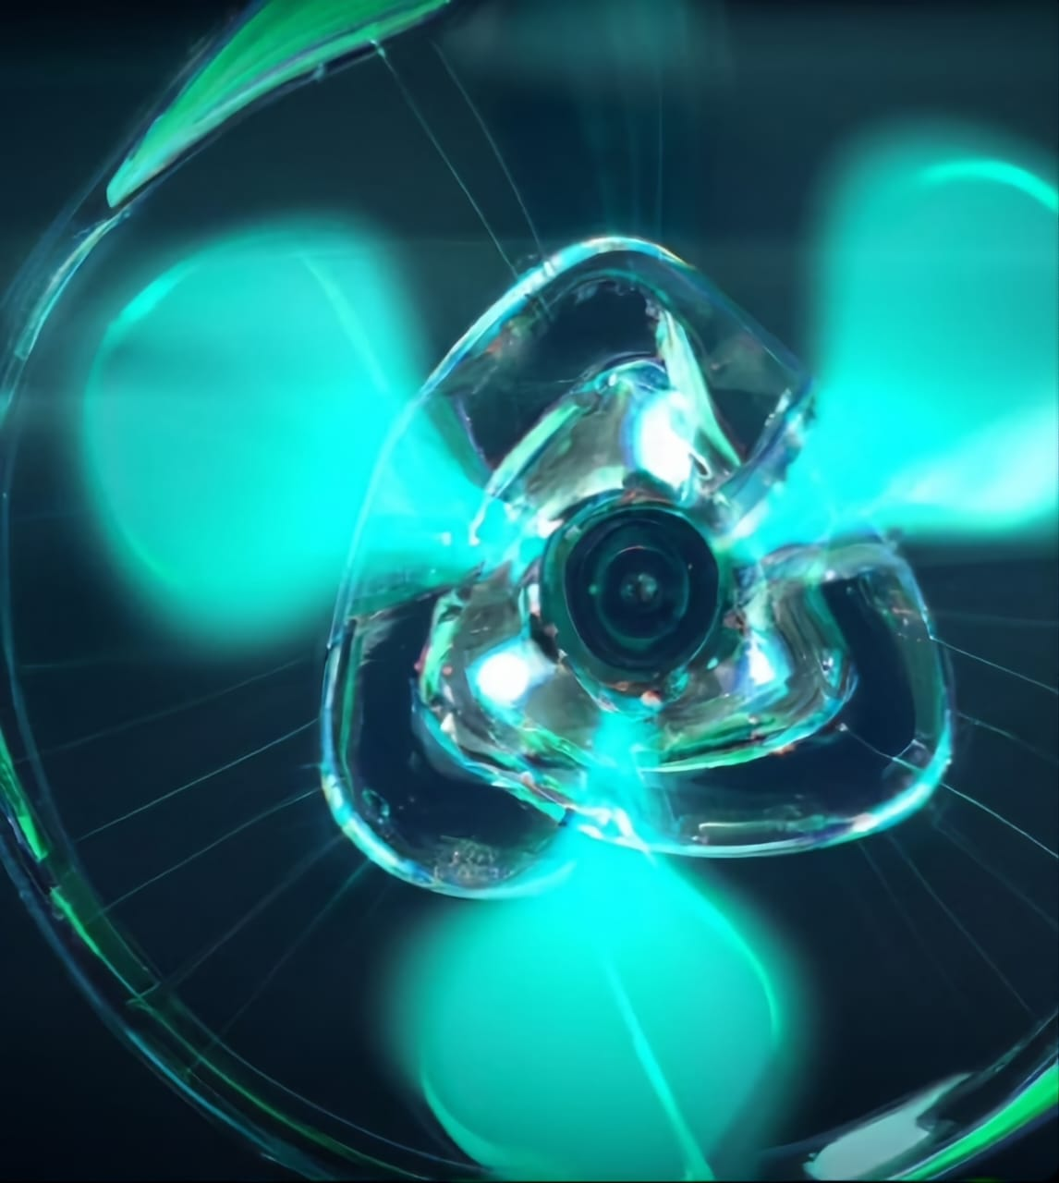
CFD ANALYSIS OF PROPELLER:
CFD can also be used to study the interactions between a propeller and its surrounding environment , such as the effect of nearby objects on the propeller’s performance. It can also be used to identify areas of potential improvement in propeller design, such as reducing noise or increasing efficiency.
CFD can provide valuable insight into the performance of a propeller. By simulating the air flow around a propeller, CFD can provide important information about the propeller’s efficiency, aerodynamic performance, and noise levels.

Slide 7
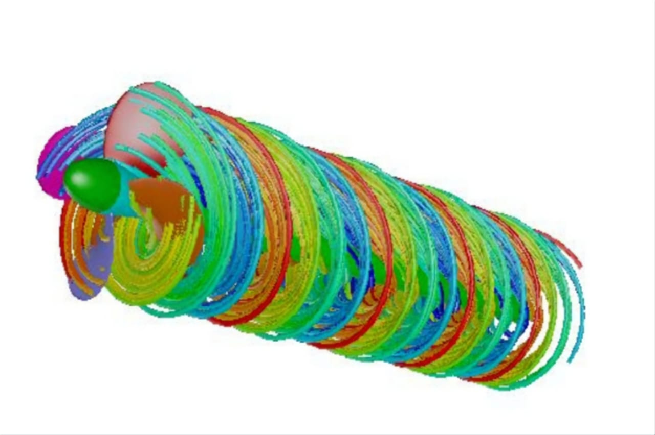
MATERIAL:
The materials from which propellers are made today can broadly be classed as members of the bronzes or stainless steels. The once popular of cast iron has now virtually disappeared, even for the production of spare propellers, in favor of materials with better mechanical and cavitation resistant properties.
The propeller in this project is made from aluminium alloy. However, the most desirable set of properties which it should posses as follows:
(i)High corrosion fatigue resistance in water
(ii)High resistance to cavitation erosion
(iii)Good resistance to general corrosion
(iv)High strength to weight ratio
(v)Good casting characteristics

Slide 8
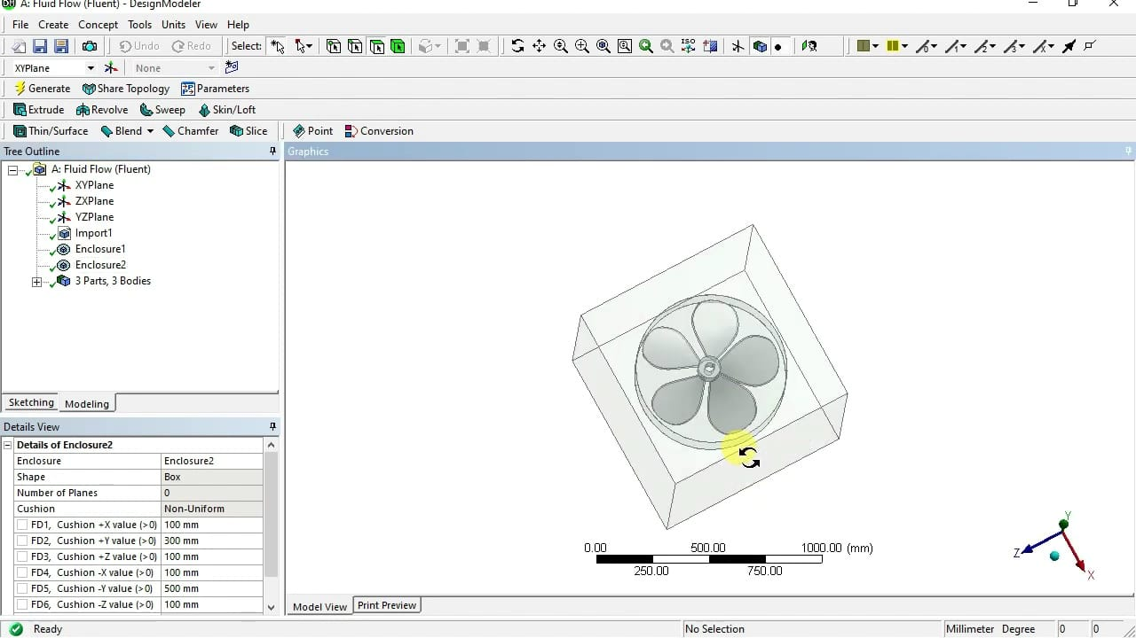
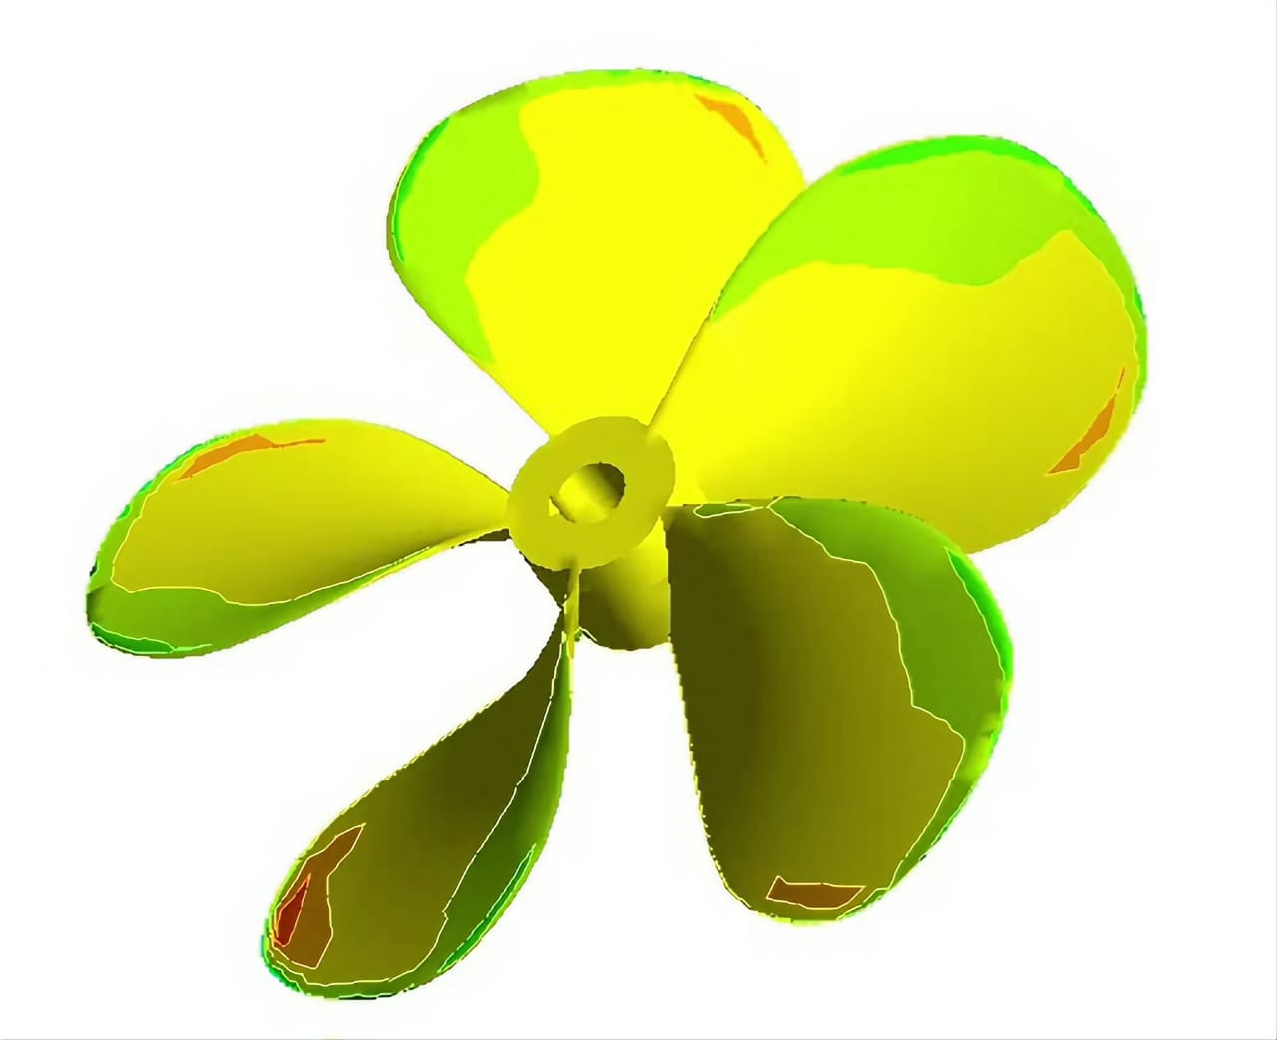


DESIGN:

Slide 9
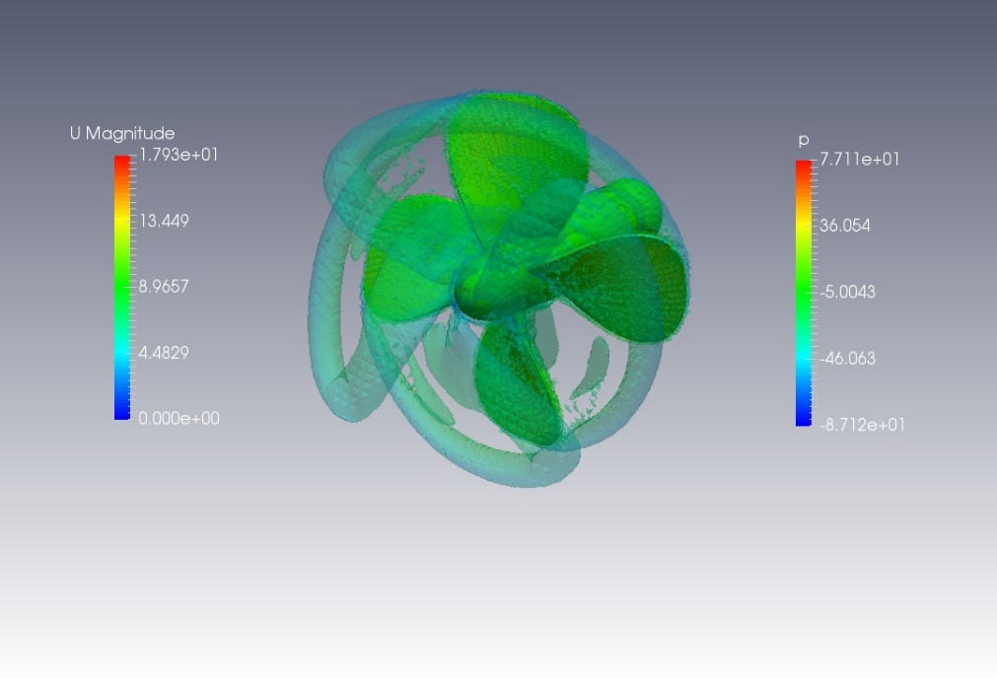
NEED FOR CFD ANALYSIS:
The automotive industry makes use of CFD for many applications, with the most important being vehicle aerodynamics. CFD analysis is used to predict drag, downforce, and stability against cornering/crosswind flow. Other automotive applications include engine combustion and thermal performance, ventilation, exhaust fumes, and more.

Slide 10
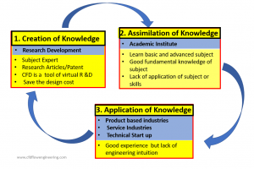
FUTURE SCOPE FOR CFD ANALYSIS:
A CFD Analysis widely in many automobile, mechanical, process and chemical, and aerospace industries. Whenever Industries carry out research and innovation of new products and services, then CFD analysis will be used in industries.
Due to an increase in computational power and well established CFD software, simulations have become affordable for both medium and large-scale industries.

Slide 11
ADVANTAGES OF CFD ANALYSIS:
CFD analysis is cost-efficient process.
CFD analysis significantly reduce the time for design.
CFD analysis offers high accuracy.
CFD analysis offers flexibility to check on different aspects.
Design optimization is made easier using CFD analysis.

Slide 12
DIS-ADVANTAGES OF CFD ANALYSIS:
Assumptions and simplifications are complicated in CFD analysis.
CFD simulations require high computational resources.
Model complexity is a major issue in CFD analysis.
Heavy limitations in turbulence modelling.
CFD is uncertain to boundary conditions.

Slide 13
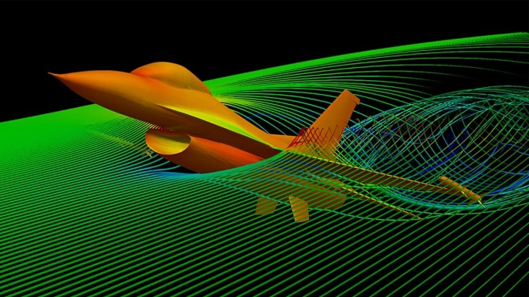
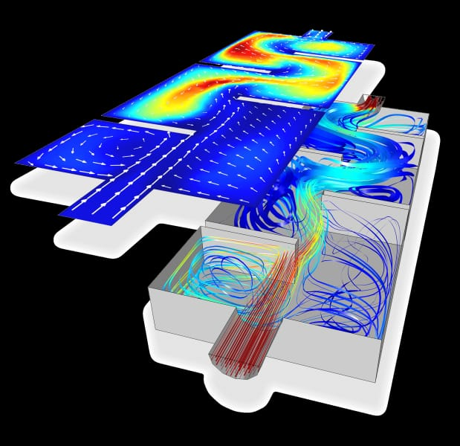
APPLICATIONS:
* CFD is used in wide range of industries, including aerospace, automotive, biomedical engineering, etc.
It is used in design of aircraft wings, car bodies, and medical devices.
It is used to optimize designs, by predicting the effects of changes in geometry or materials on the flow system.

Slide 14
3D Models Of Different Types of Propeller By Catia V5 Software

Slide 15
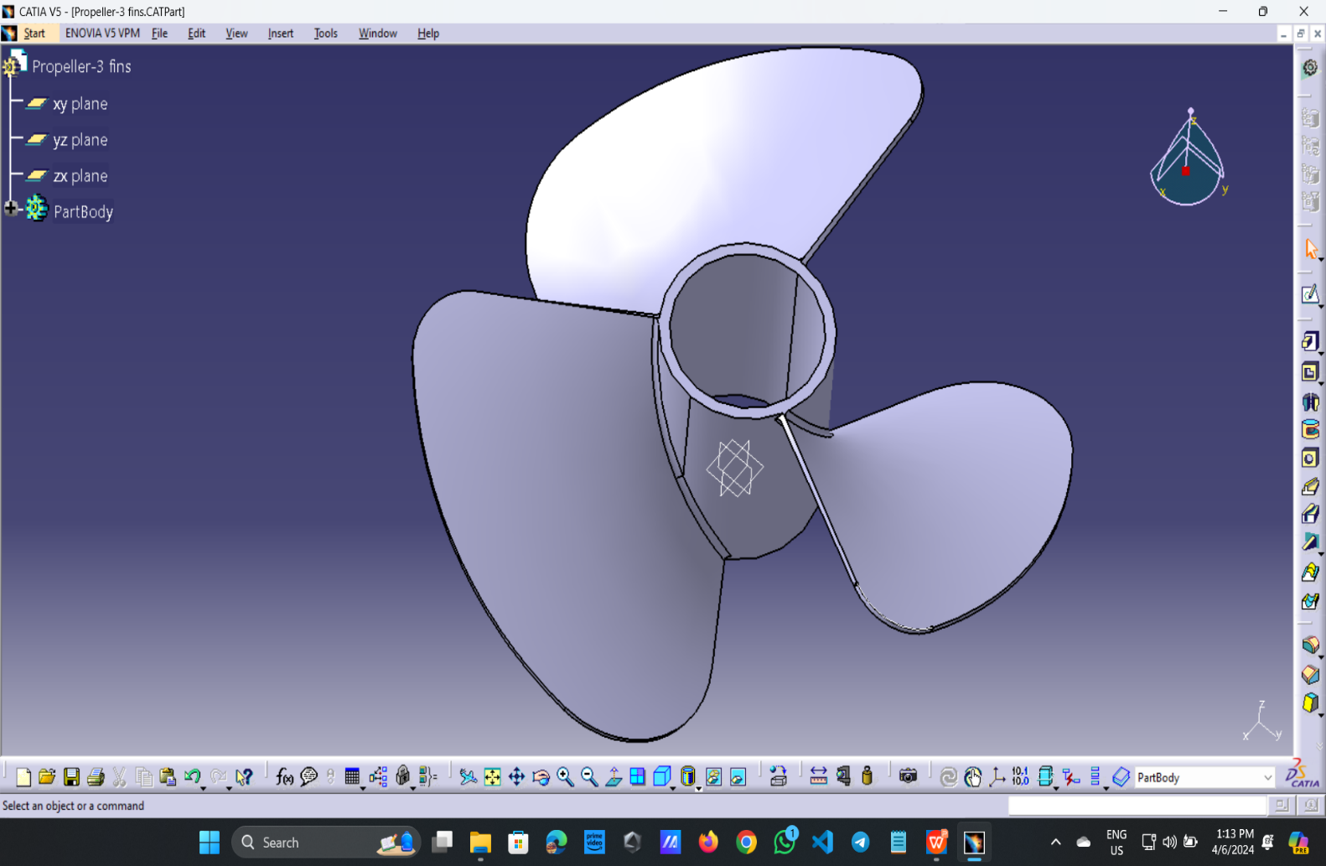
Propeller with 3 Fins
S. No | Properties | Dimensions
1 | Dia of Hub | 30 mm
2 | Dia of fins | 120 mm
3 | Extrude of Hub & fins | 40 mm
4 | Fillet of corners | Upside-10 mm Bottom side-10mm
5 | Material | Aluminium
6 | Thickness of propeller | 1 mm

Slide 16
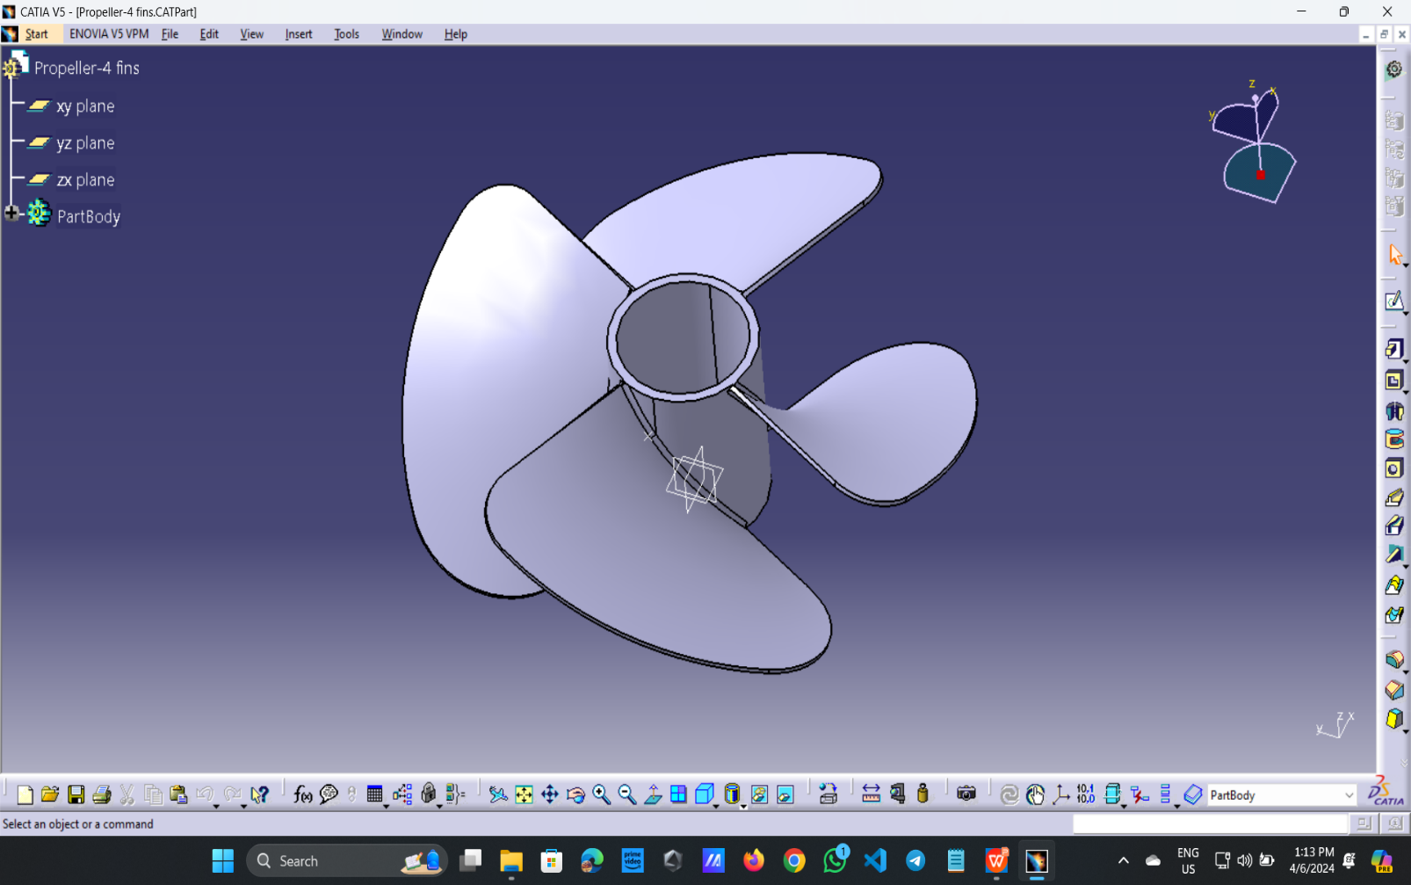
Propeller with 4 Fins
S. No | Properties | Dimensions
1 | Dia of Hub | 30 mm
2 | Dia of fins | 120 mm
3 | Extrude of Hub & fins | 40 mm
4 | Fillet of corners | Upside-10 mm Bottom side-10mm
5 | Material | Aluminium
6 | Thickness of propeller | 1 mm

Slide 17
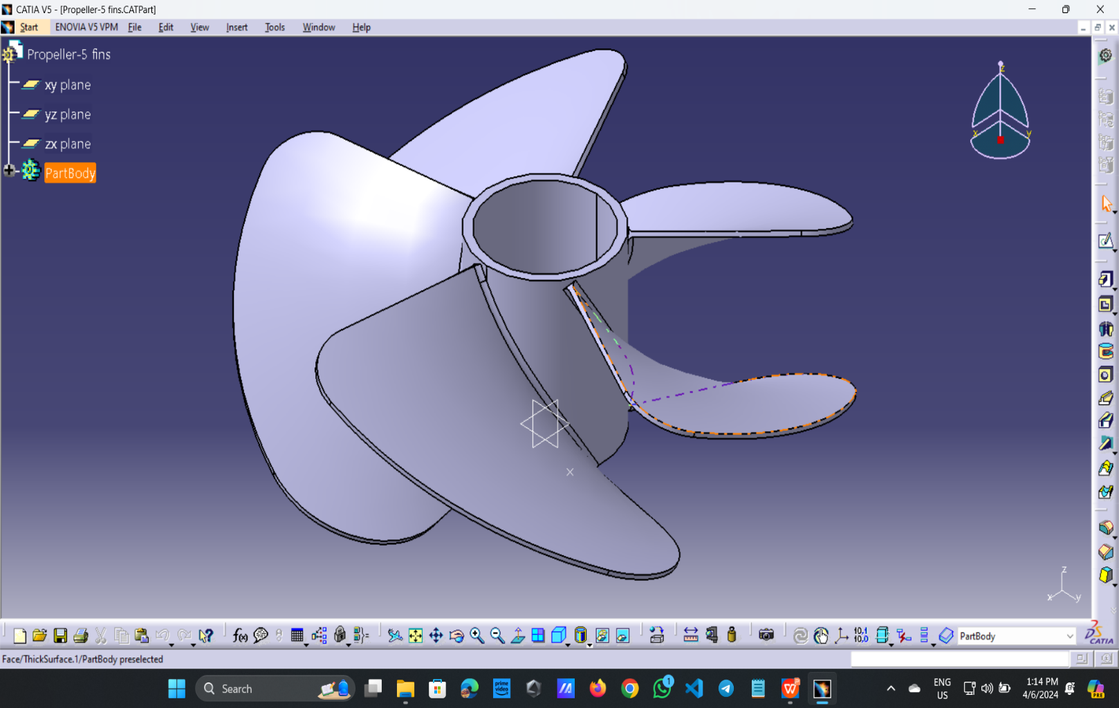
Propeller with 4 Fins
S. No | Properties | Dimensions
1 | Dia of Hub | 30 mm
2 | Dia of fins | 120 mm
3 | Extrude of Hub & fins | 40 mm
4 | Filet of corners | Upside-10 mm Bottom side-10mm
5 | Material | Aluminium
6 | Thickness of propeller | 1 mm

Slide 18
Simulation & Analysis of Propeller by using Ansys Software 2024 R1

Slide 19
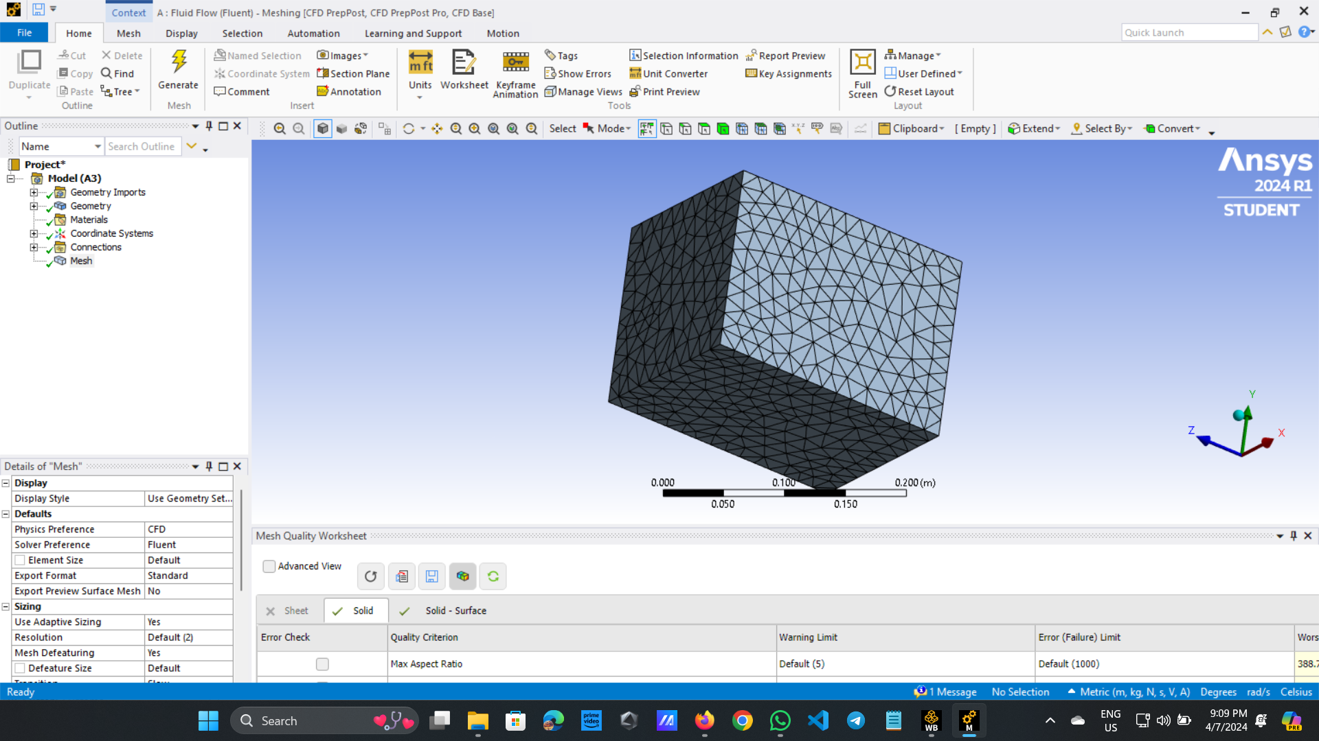
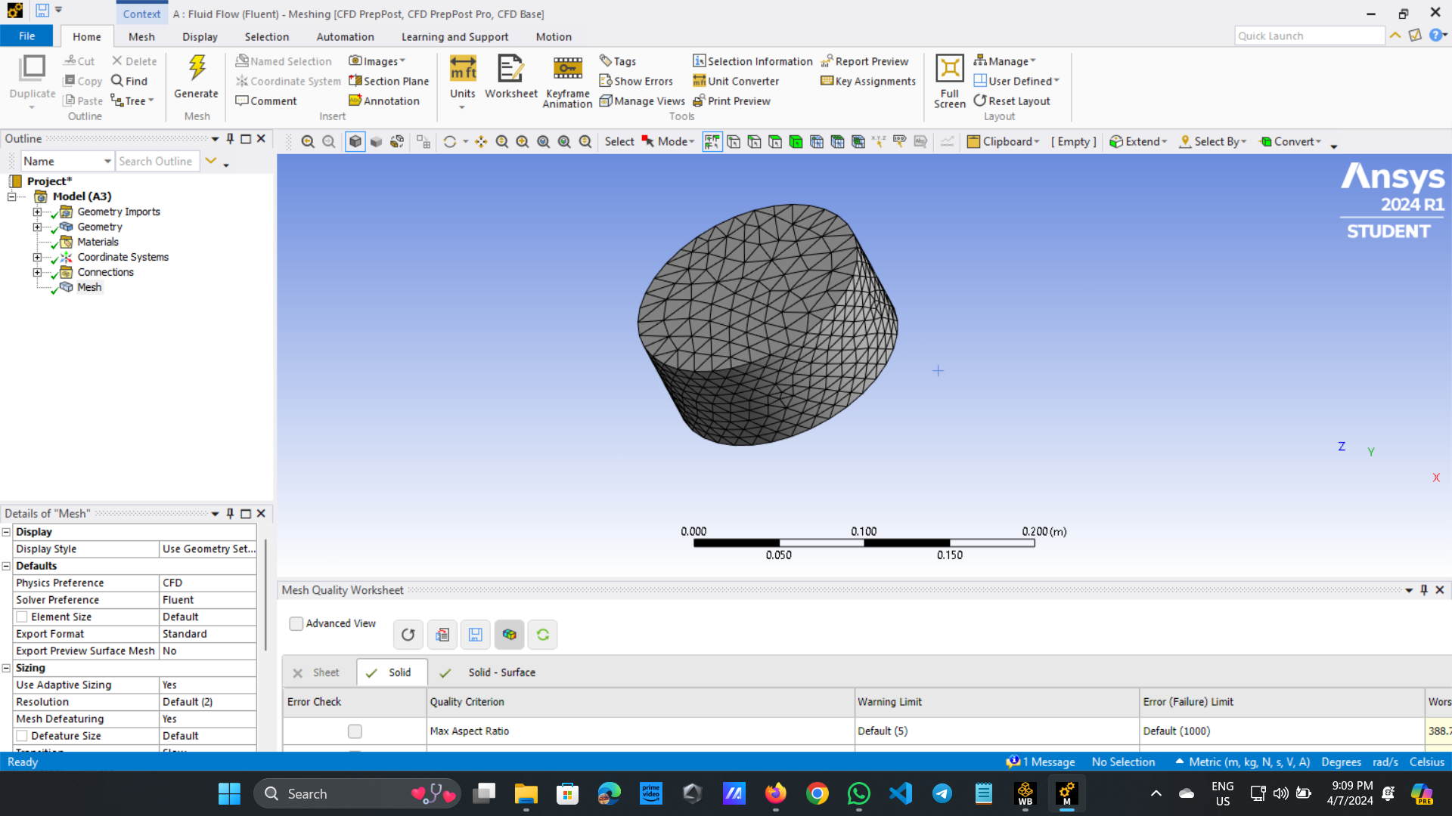
Meshing:

Slide 21
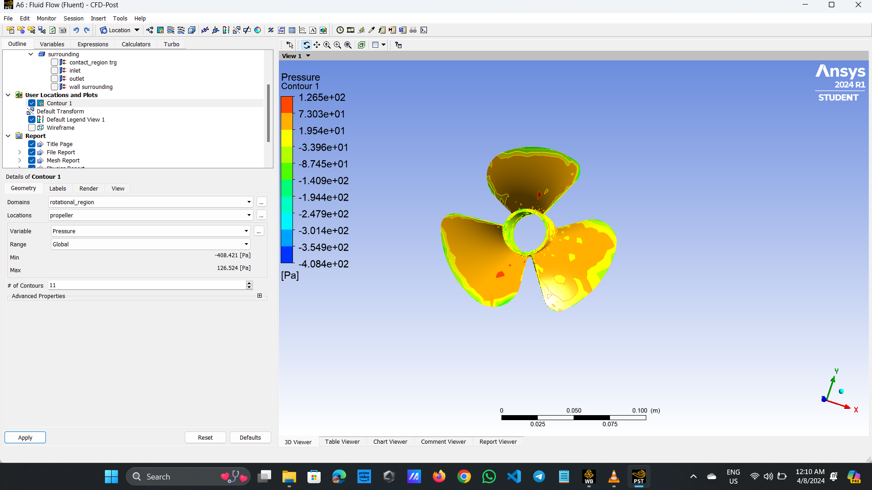
Analysis: 3 fins Propeller of Pressure

Slide 22
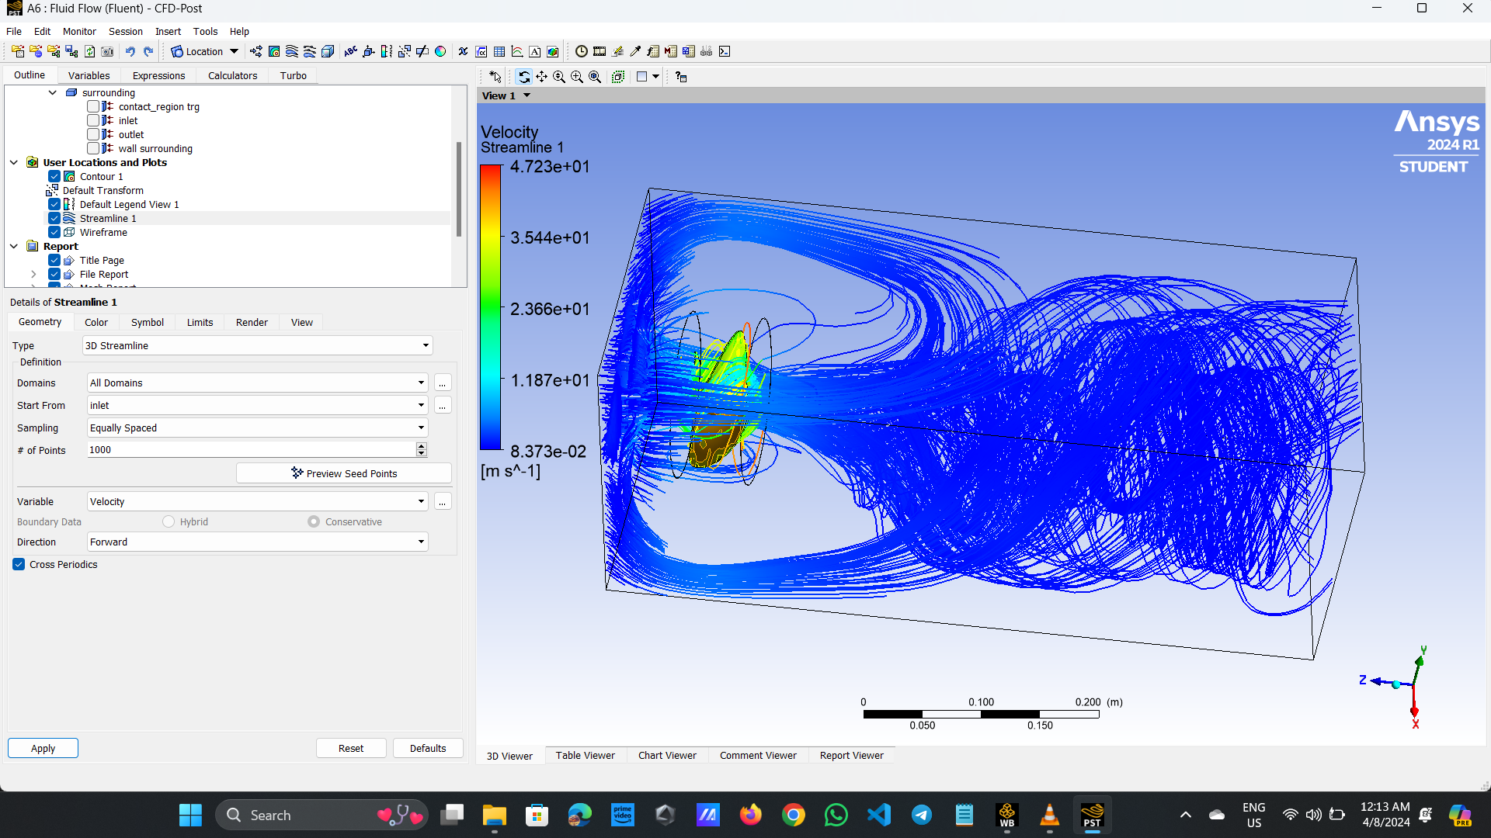
Velocity:

Slide 23
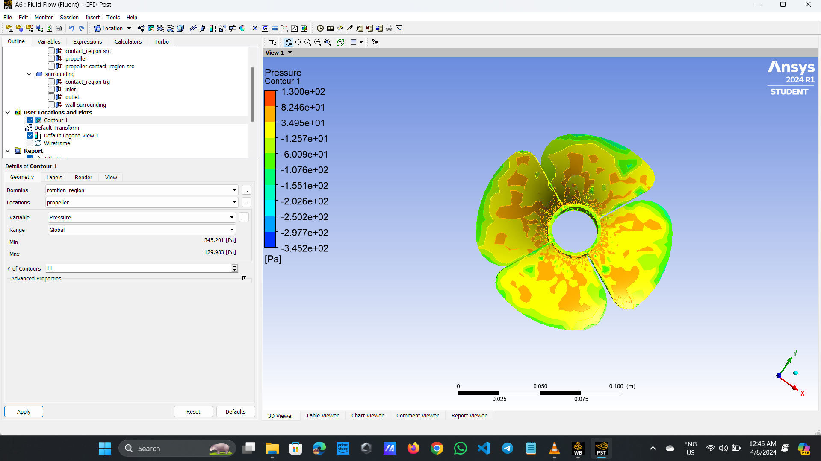
Analysis :4 Fins Propeller of Pressure

Slide 24
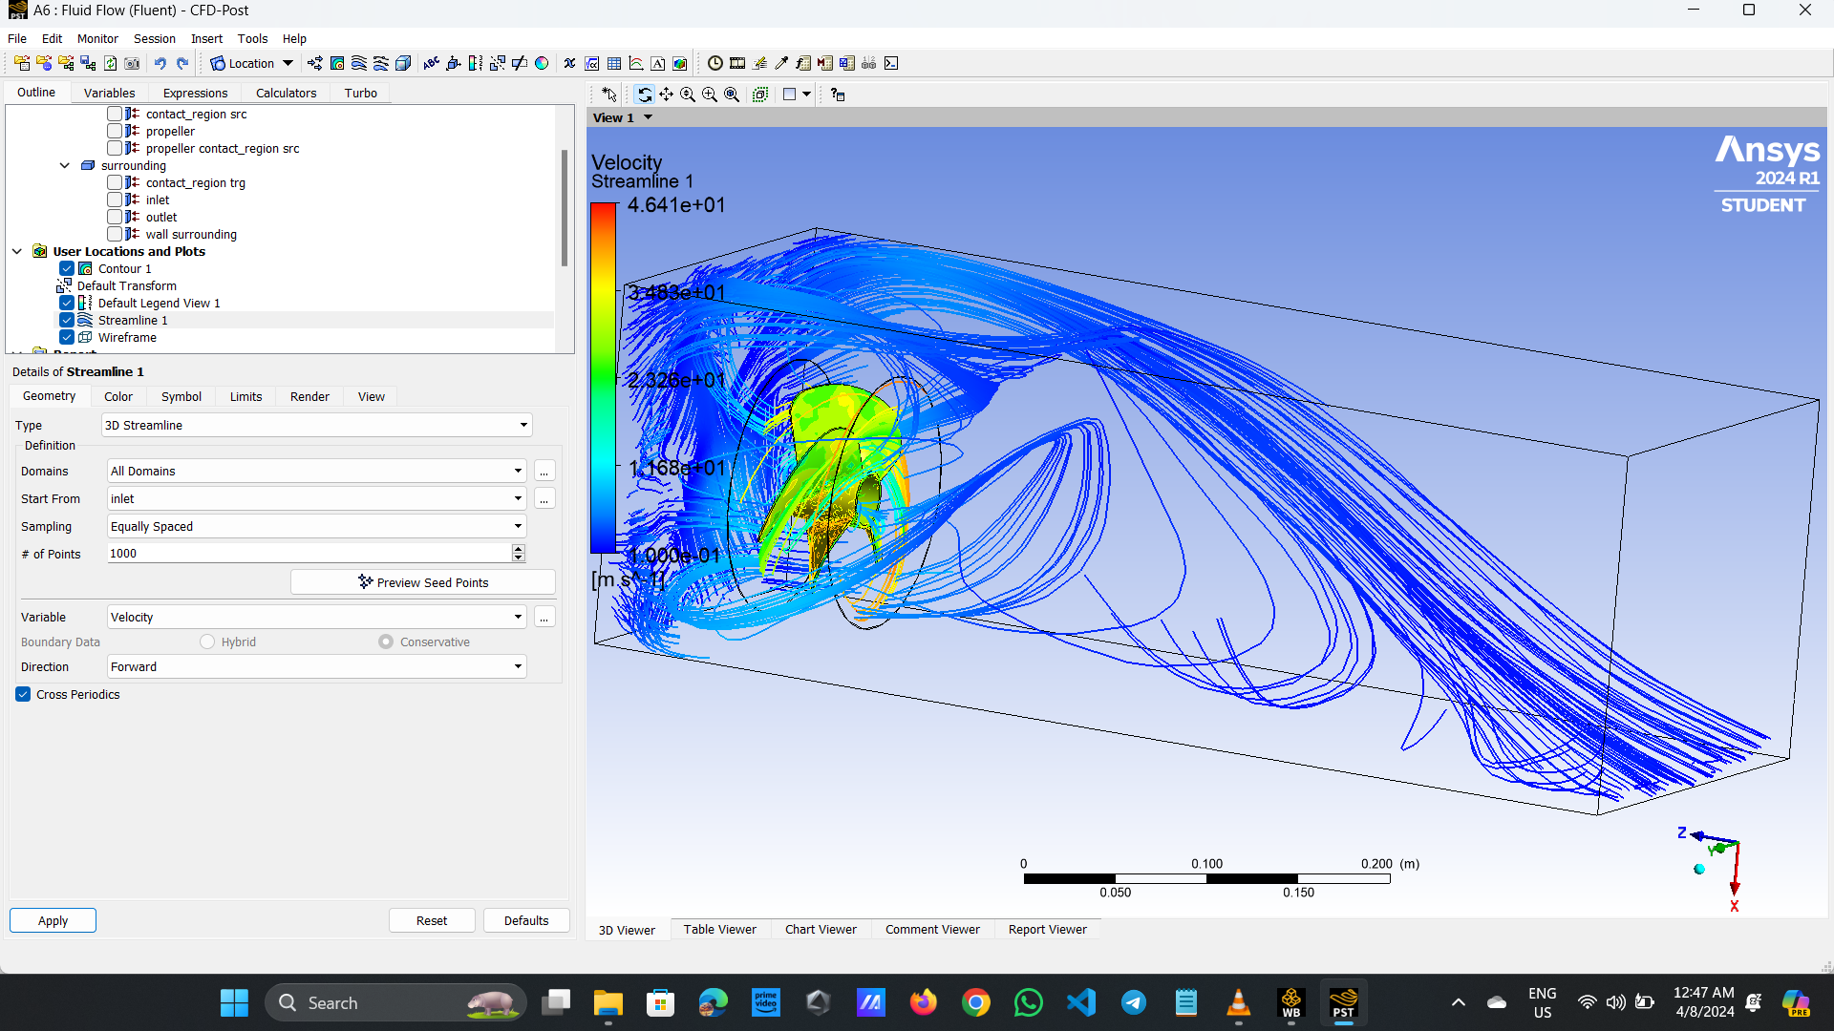
Velocity :

Slide 25
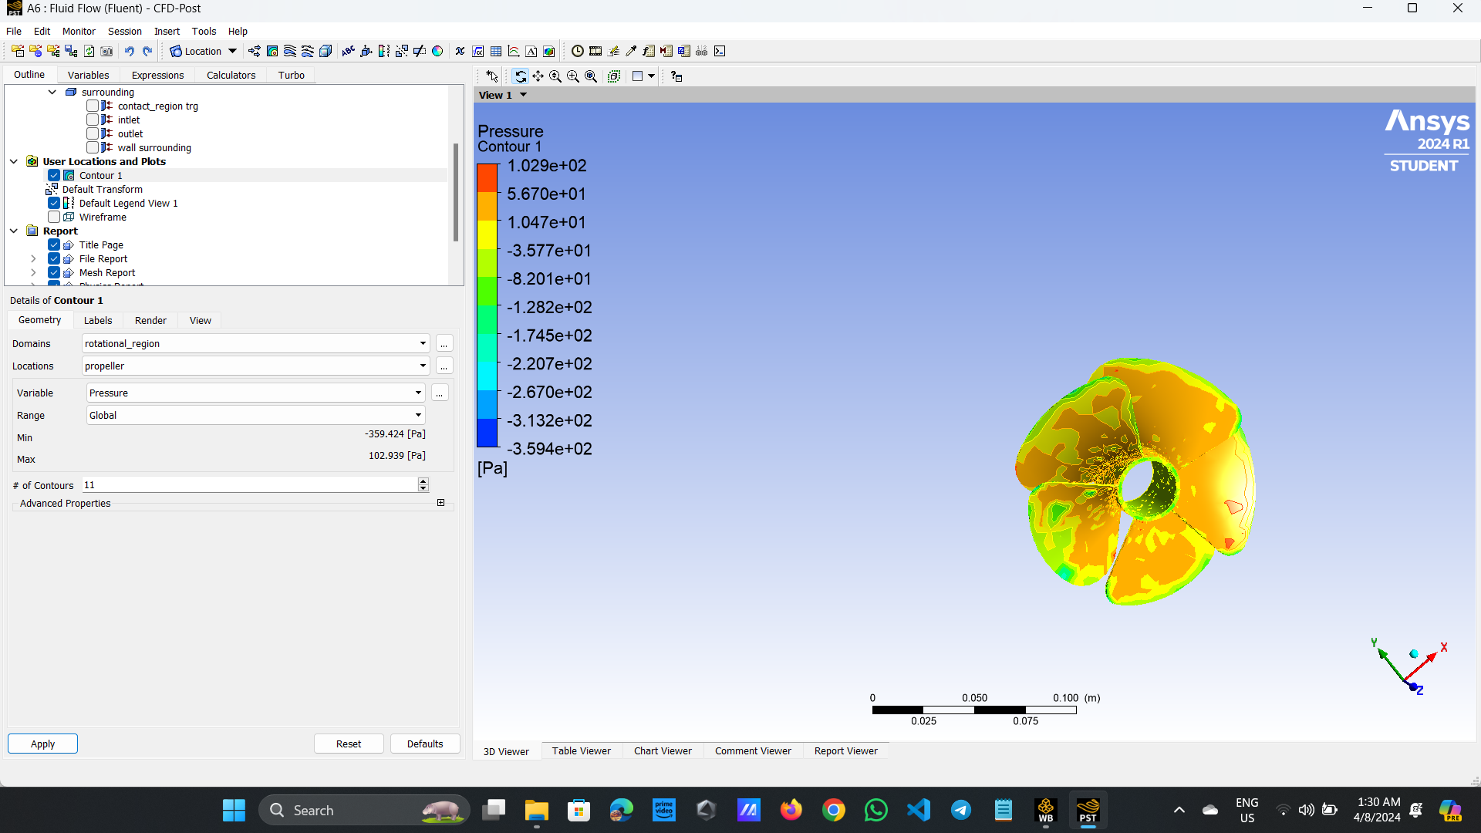
Analysis:5 Fins of Propeller Pressure:

Slide 26
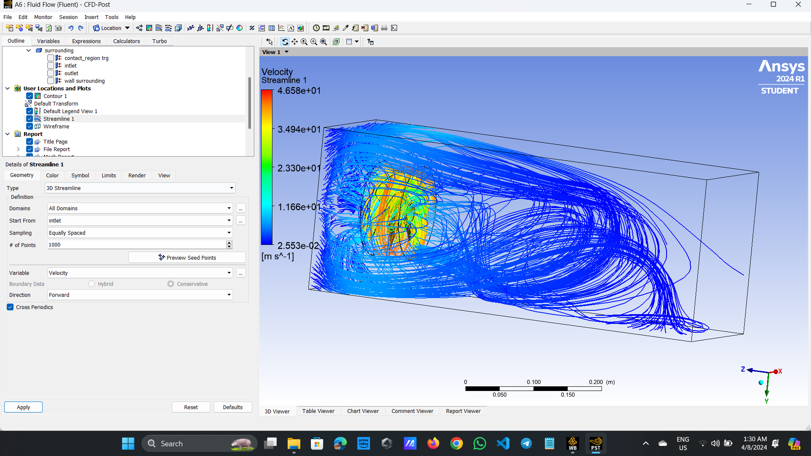
Velocity:

Slide 27
Comparations :
Pressure:
CFD simulations provide insights into the pressure distribution around propeller blades, crucial for assessing performance and efficiency. High-pressure regions typically occur near blade leading edges, while low-pressure zones form near trailing edges.
Impact on Performance: Understanding pressure distribution aids in optimizing propeller designs for enhanced efficiency and reduced cavitation risk. It helps identify areas of high pressure that may cause structural concerns or inefficiencies, guiding design modifications.Simulation Challenges: CFD analysis of propellers poses challenges due to complex flow phenomena, including boundary layer separation, vortex shedding, and blade-wake interactions. Proper turbulence modeling and grid resolution are essential for accurate pressure predictions.

Slide 28
Pressure Contour:(units-Pascal)

Slide 29
Velocity Streamline
Flow Visualization of Velocity streamlines in CFD simulations allow visualization of the flow patterns around propeller blades. They reveal how the fluid moves through and around the blades, indicating areas of acceleration, deceleration, and separation.
Performance Assessment by analyzing velocity streamlines, engineers can assess the effectiveness of propeller designs in generating thrust and minimizing flow disturbances. Smooth, well-aligned streamlines indicate efficient propulsion, while irregularities suggest areas for improvement.
Optimization Opportunities is easy to understanding velocity streamlines facilitates propeller optimization by identifying regions of flow recirculation, separation, or excessive turbulence. Adjustments to blade geometry or pitch distribution can be made to improve flow alignment and enhance propeller performance.

Slide 30
Velocity Streamline:(units-ms^-1)

Slide 31
Conclusion:
The computational fluid dynamics (CFD) analysis comparing different types of propellers using CATIA and ANSYS software yielded valuable insights into their performance characteristics.
By systematically assessing thrust generation, efficiency, and flow patterns under specific operating conditions, we gained a comprehensive understanding of each propeller design's strengths and weaknesses.
Our methodology involved meticulous simulation setup, including computational meshing techniques and careful consideration of boundary conditions. The results revealed distinct performance profiles for each propeller, with variations in thrust generation(pressure), efficiency, and pressure distributions.. Validation against experimental data confirmed the accuracy of our simulations, further enhancing the credibility of our findings. Moving forward, our study suggests opportunities for optimizing propeller designs and refining simulation methodologies to better capture real-world performance.
The computational fluid dynamics (CFD) analysis conducted on the Four-fins Aluminum Propeller consistently yielded superior results across various performance metrics compared to alternative designs.
Overall, this research contributes valuable insights to the field of propeller design and highlights avenues for future exploration and improvement.

Slide 32
Thank you.....

